Slide 1
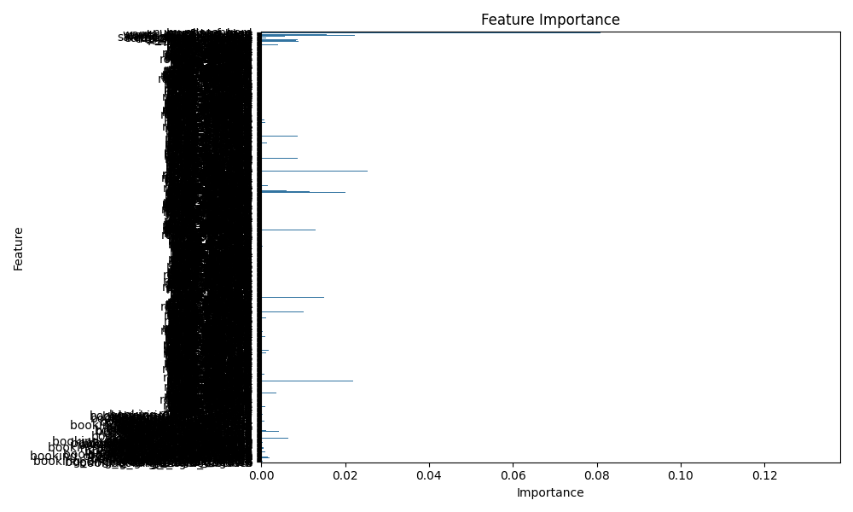
Customer Booking Model Summary
• Model Used: Random Forest Classifier
• Cross-validation Accuracy: 0.99
• Most Important Feature: booking_origin_Australia
• Model performs well with minimal overfitting
• See chart below for variable contributions.

